Slide 1
Contextual inquiry
ECE 695
Alexander J. Quinn
February 22, 2016

Slide 2
What would improve this experience?
Credit: http://www.gettyimages.com/detail/video/desk-man-tablet-stock-footage/480552610

Slide 3
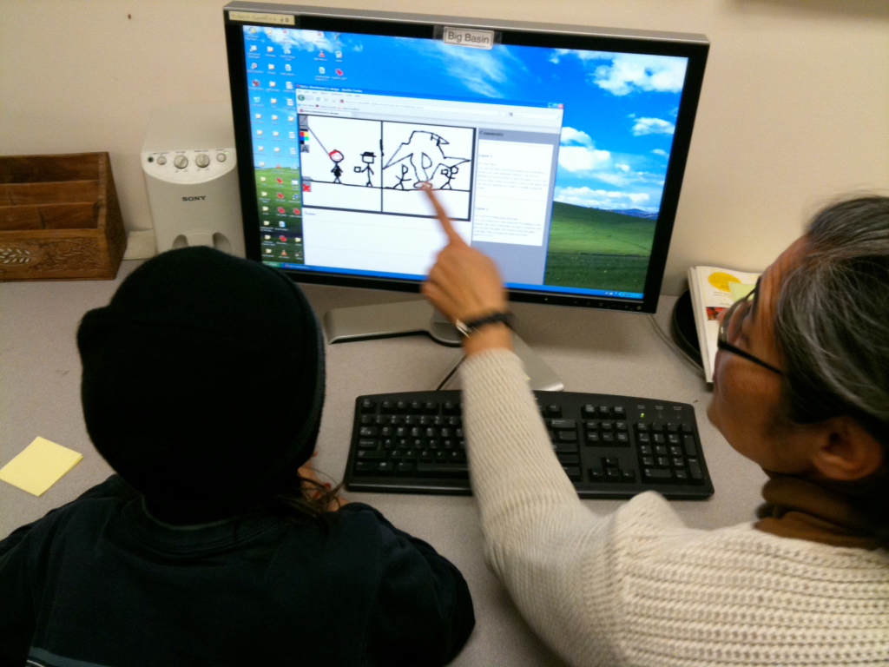
What would improve this experience?
Credit: Elizabeth Bonsignore

Slide 4
Contextual design: scope
Step-by-step for understanding human activities and designing to improve them
Tested methodology
Incorporates other best practices

Slide 5
Contextual design: Stages
Conduct interviews and observations
Model activity
Consolidate
Design improvements to process
Design improvements to tools, environment
Create prototypes
Evaluate
Implement
(later, rinse, repeat)

Slide 6
Contextual inquiry: scope
Conduct interviews and observations
Model activity
Consolidate
Design improvements to process
Design improvements to tools, environment
Create prototypes
Evaluate
Implement
(later, rinse, repeat)

Slide 7
Contextual inquiry
Acquire data
Goal: Exposure to what you don’t know
Organize data
Goal: Understand
Generalize across users
Goal: Synthesize

Slide 8
Master-apprentice model
Observe user
1-2 hours at a time
Give them warning before you come
Let them teach you about their job
It may be a bit like training a new employee
Teach them to teach you

Slide 9
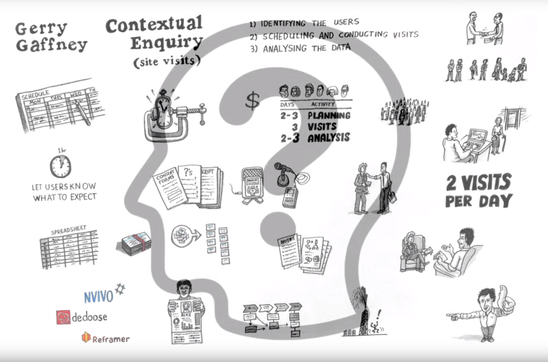
Video
https://youtu.be/mOWeNnSY5M0
Credit: Gerry Gaffney, uxmastery.com

Slide 10
Exercise: Contextual inquiry
Perform a mini- contextual inquiry
Task: “Find a very relevant paper and send it to a friend in a nice, readable email”
Explain what you will do as though the person did not know about contextual inquiry
Round 1: Android users learn from an iPhone user
Round 2: iPhone users learn from an Android user
Time limit: 5½ minutes

